Slide 1


TEAM GRAVITY
PRESENTS
This Photo by Unknown Author is licensed under CC BY-SA

Slide 2

PROBLEM STATEMENT
Develop a web scraping tool that extracts internship listings from 5-6 popular internship sites, such as Indeed, Glassdoor, or Internshala. The tool should allow users to input their skills, interests, and other preferences, such as the type of internship, location, and whether it is paid orunpaid. The tool should then use data science techniques, such as natural language processing and clustering, to recommend relevant internship opportunities to the user.
This Photo by Unknown Author is licensed under CC BY-SA

Slide 3

TECHNOLOGY USED
HTML 5
CSS
JAVASCRIPT
PYTHON
DJANGO
SQLite Database
Bootstrap
This Photo by Unknown Author is licensed under CC BY-NC

Slide 4

APPROACH
An internship program offers the opportunity to begin training future employees while they are still in educational institutes. Our website gathers the information regarding various internship’s vacancies available and it recommend them to users according to their area of interests, skills, types like paid or unpaid ,online or offline and on the basis of the reviews of the employees that have worked at that particular position before , it also helps the user by providing them resources in order to prepare for the recruitment process.

Slide 5
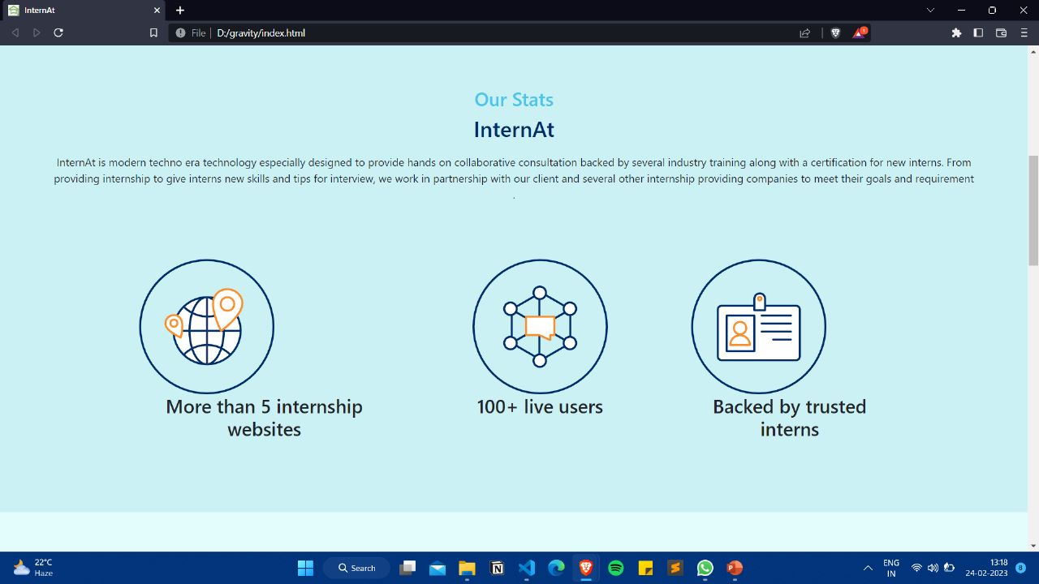
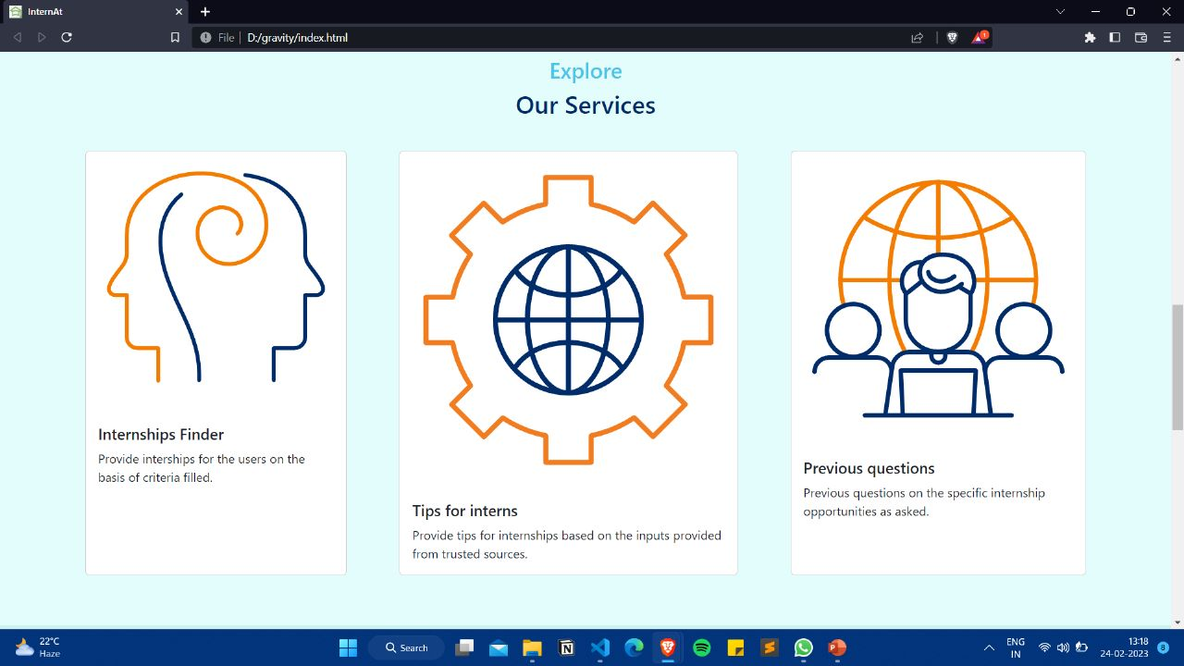
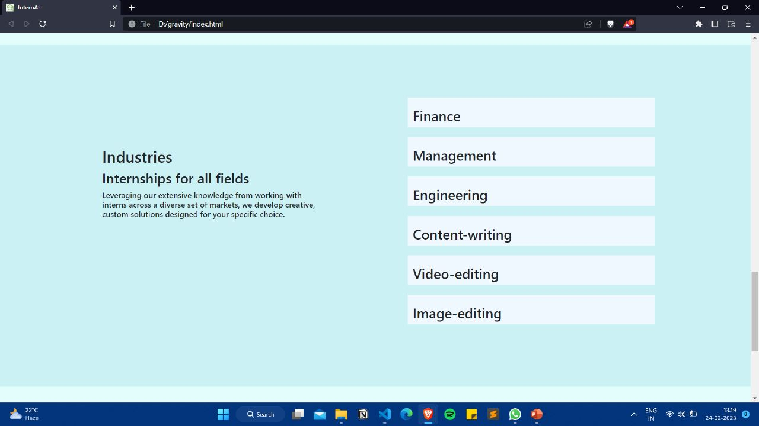
Home page

Slide 6
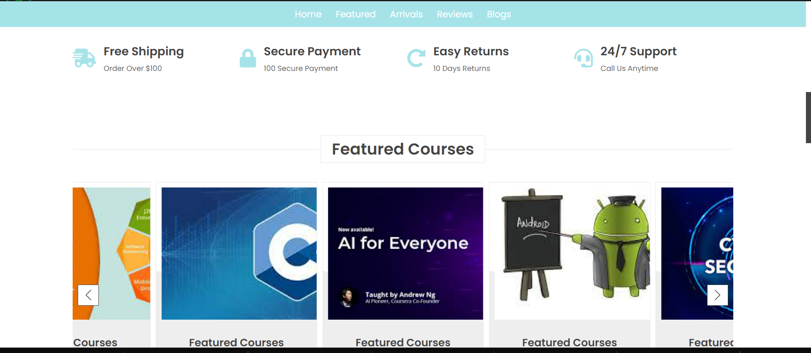
Continue :

Slide 7
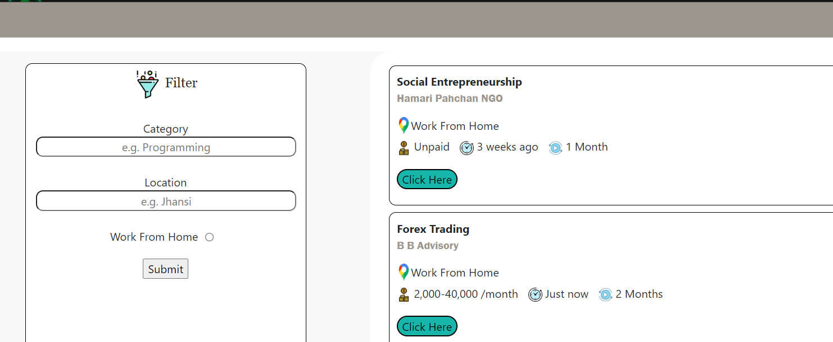
Example :-

Slide 8
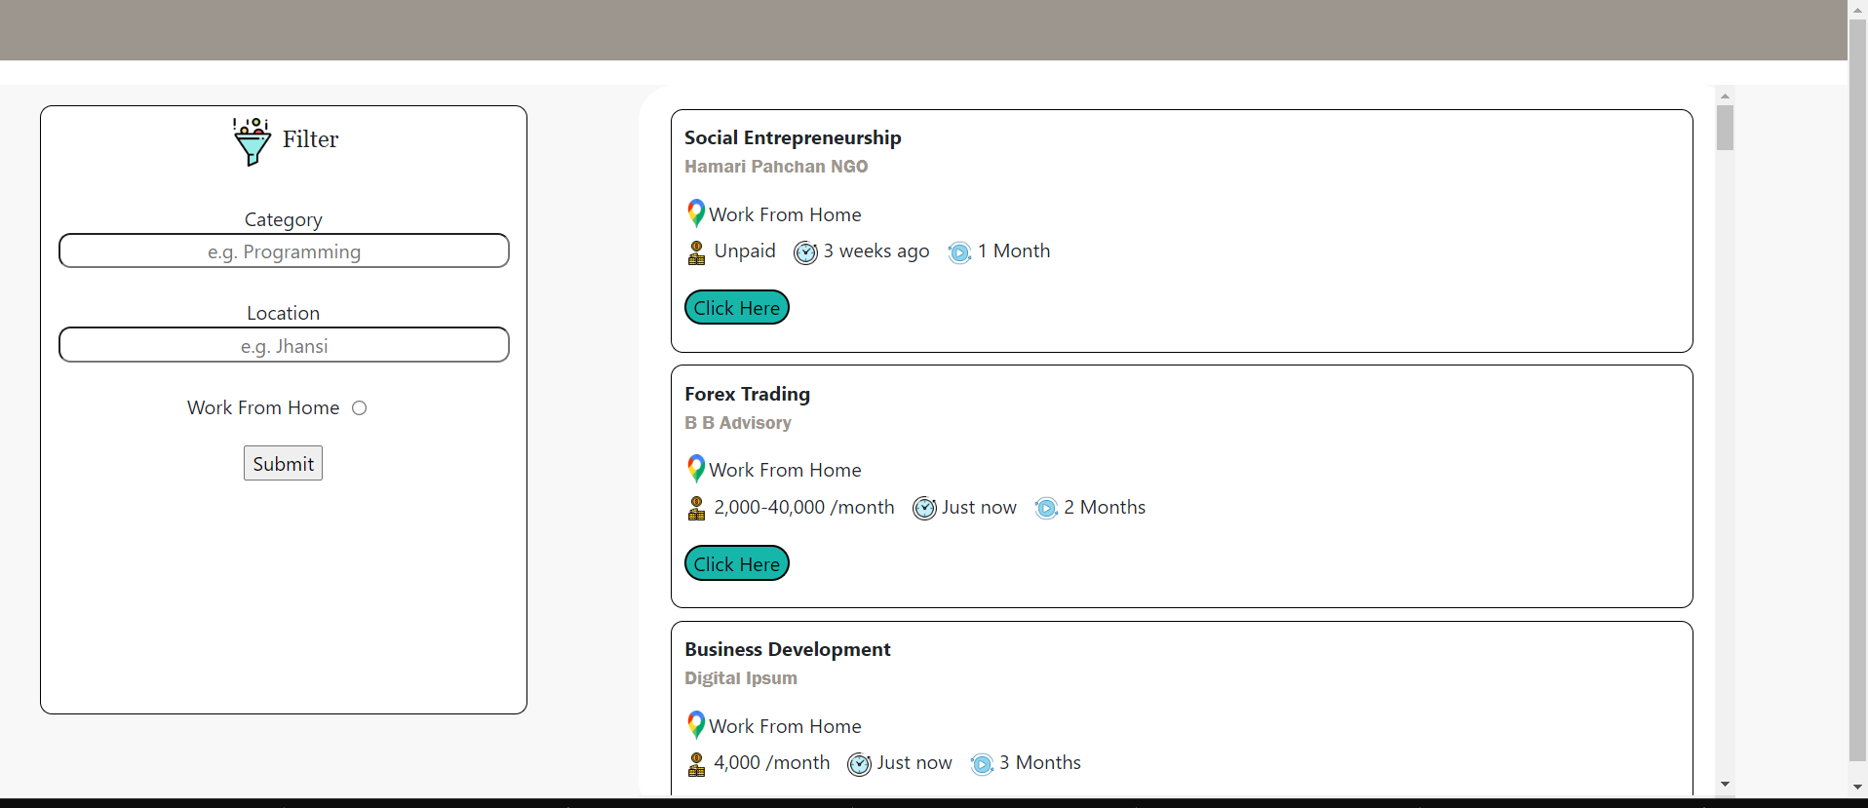

Slide 9

ADVANTAGES :
It is much more interactive and attractive interface which provide one to one personalized experience for all the users.
It makes easy for user to search about all the possible internship in a single website on the basis of their professional skills.
It provide all the sites at a one place and makes it easy for all the interns to get their suitable internship as per their professional skills.

Slide 10

FUTURE SCOPE :
Talking from business perspective we will try to either tie up with more trusted MNC's for further expansion or will reduce the number of companies in order to build our own company and provide a new model for company to grow. While with respect to technical aspect we will be applying machine learning and deep learning to make the internship available for the users from their previous interaction and their expertise. This will make our website more interactive and user friendly

Slide 11

Thank You
TEAM MEMBERS
ROHIT SHANKAR SINHA
RITIK RATHORE
SURYANSH RUHAL
ARYAN DEEVOLIYA
AYUSH SHRIVASTVA

Slide 12

FEEDBACK

